Slide 1
Cyclistic Bikes- Portfolio Project

Slide 2


Slide 3
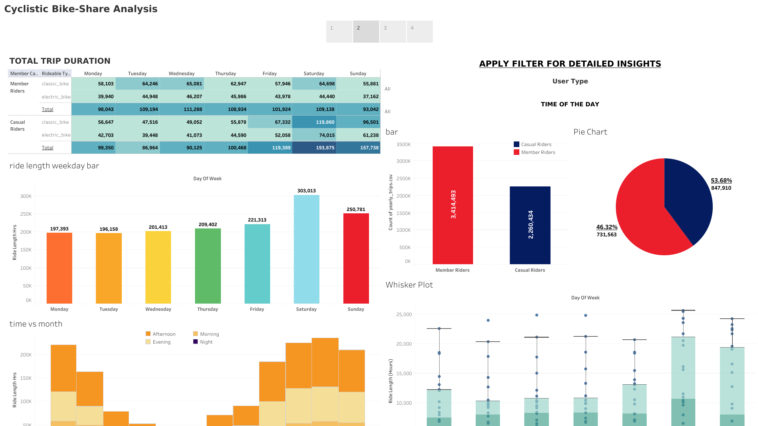

Slide 4
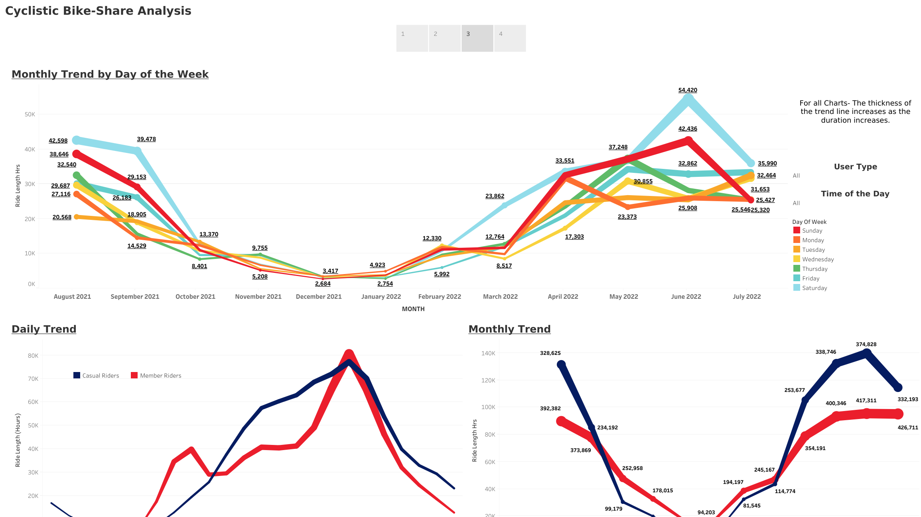

Slide 5
